Slide 1
The Strangest Robots Ever Created
Svetlichnaya Alina

Slide 2
- You are a clever imitation of life... Can a robot write a symphony? Can a robot take a blank canvas and turn it into a masterpiece?
-Can you?

Slide 3
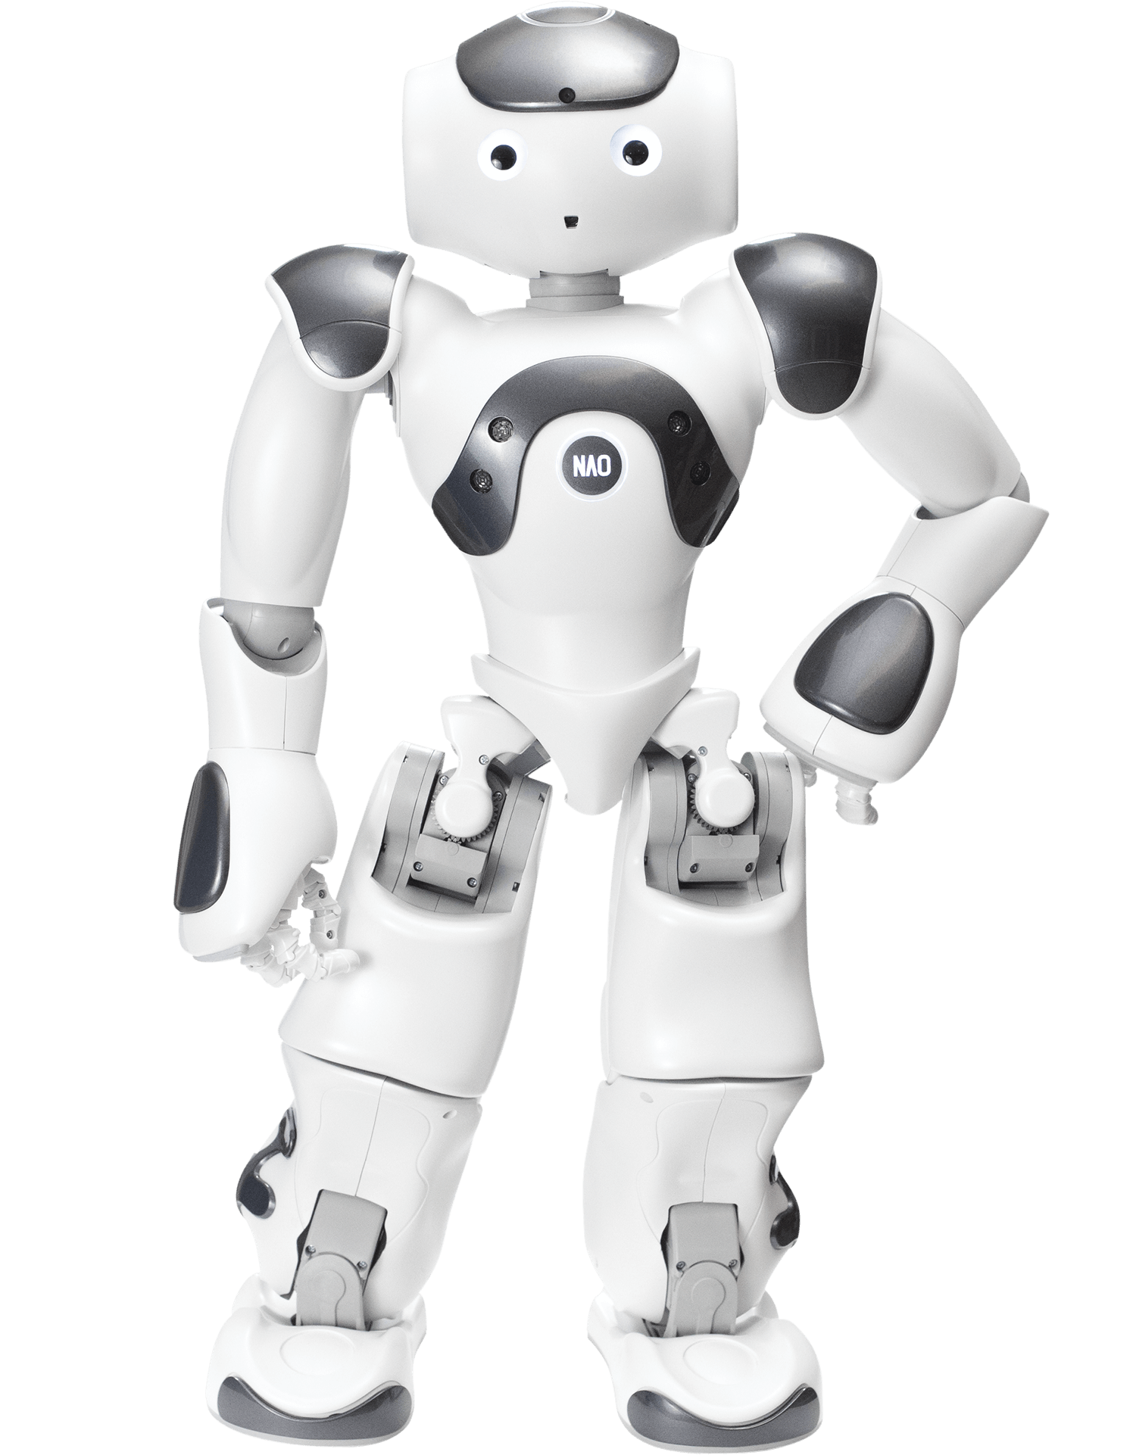
01.
NaoRobot

Slide 4
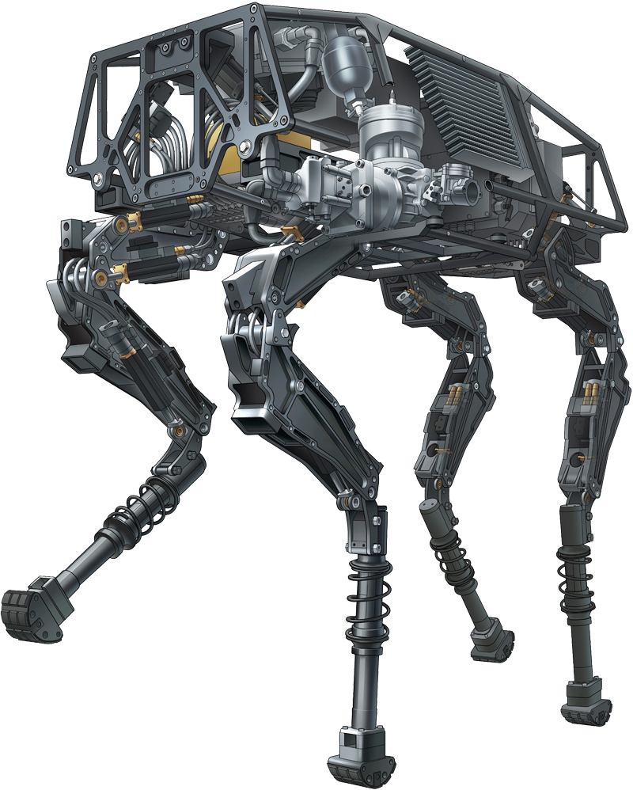
02.
BigDog

Slide 5
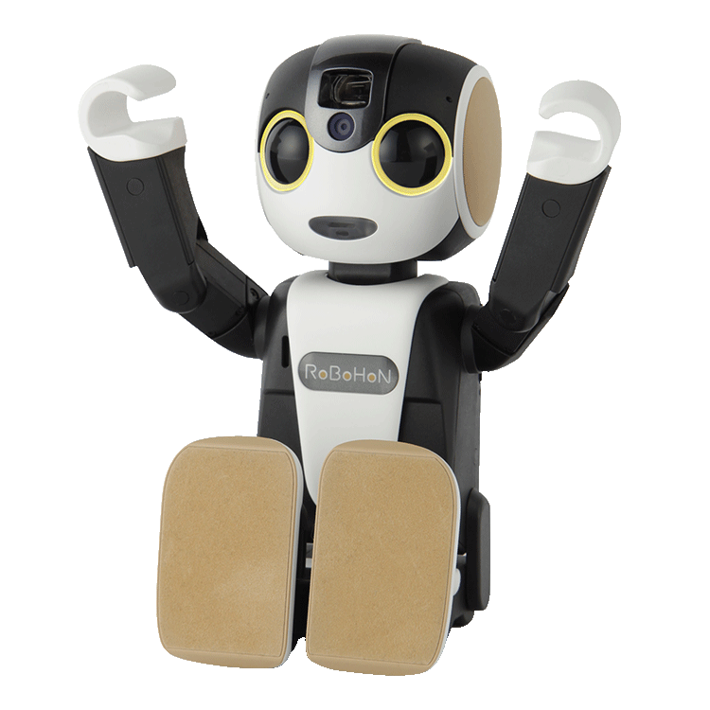
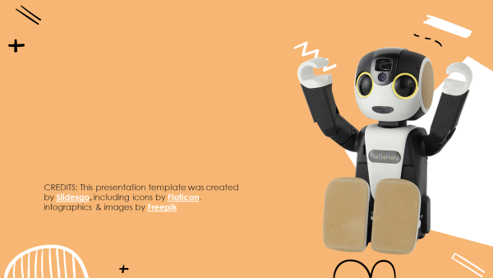
03.
RoBoHon

Slide 6
Thank
You

